Slide 1

Basics of HTML & CSS
Part 2

Slide 2
Outline
HTML tables
HTML forms
Input elements
HTML dropdowns

Slide 3
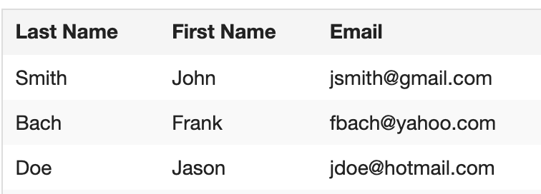
HTML tables
<table></table> tag is used to create a table in an HTML document
<th></th> is used to define the headers of each column in a table
<tr></tr> is used to define the rows of the table
<td></td> is used to define table data/cell
NOTE: We can group column headers in a <thead></thead> tag and content of the table in a <tbody></tbody> tag
EXAMPLE: Create below table

Slide 4
HTML forms
<form></form> tag is used to create a form in an HTML document, and it is used to collect data from user
<input></input> tag is the most common tag used with the form
There are different input types as listed below
<input type=”username"> is used to display a single-line username text field
<input type=”password"> is used to display a single-line password text field
<input type="text"> is used to display a single-line text field
<input type=”submit"> is used to display a submit button
<input type=”button"> is used to display a clickable button
<input type=”radio"> is used to display a radio button (selecting one item from list)
<input type=”checkbox"> is used to display checkbox (selecting multiple items)
The <label> tag defines a label for many form elements.
<textarea></textarea> tag is often used in a form, to collect user inputs like comments or reviews

Slide 5
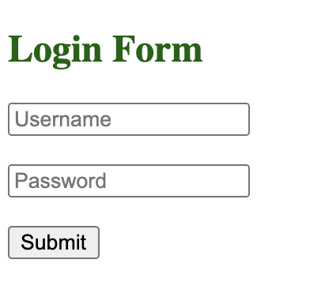
Exercise Build a login form as displayed in the image

Slide 6
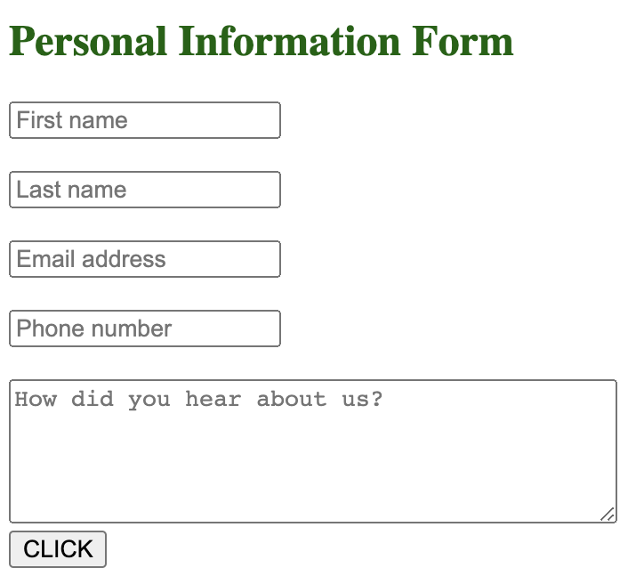
Exercise Build a personal info form as displayed in the image

Slide 7
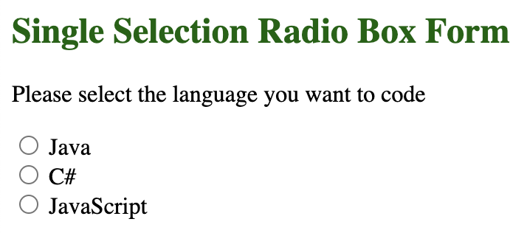
Exercise Build a radio buttons form as displayed in the image

Slide 8
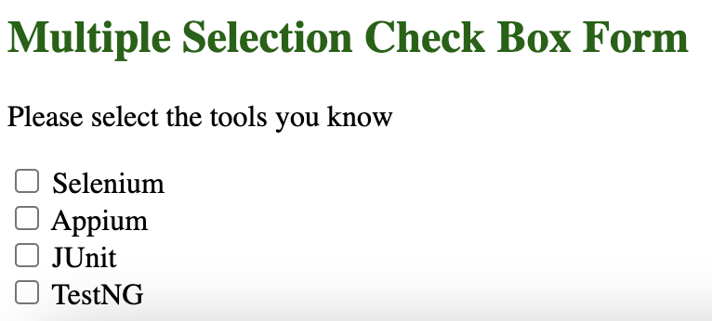
Exercise Build check boxes a form as displayed in the image

Slide 9
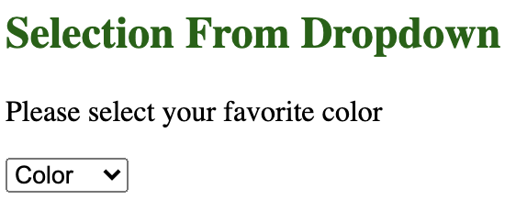
HTML dropdowns
<select></select> tag is used to create a dropdown in an HTML document, and it is used to list items in a dropdown
It is mostly used in a form, to collect user data
The <option></option> tags inside the <select></select> tag define the available options in the dropdown list
EXAMPLE:
Create a dropdown that lists colors as options to be selected by user

Slide 10
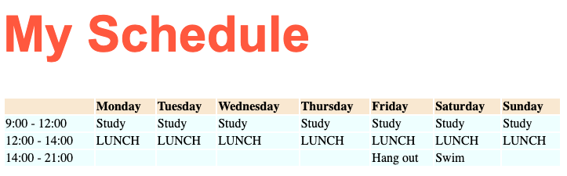
Assignment
CREATE A Schedule Table as shown below.

Slide 11
Assignment
CREATE AN APPLICATION FORM
Go to TechGlobal website at www.techglobalschool.com
Click on “APPLY NOW” link in the header
You will see an example Application form

